Slide 1
Fixed-outline Chip Floorplanning
電機三 莊佾霖 鄭佳維

Slide 2
a fixed-outline chip floorplanner that can place all hard macros within a rectangular chip without any overlaps

Slide 3
Outline
Data structure
Simulated annealing
Tuning
Reflection

Slide 4
Data Structure

Slide 5
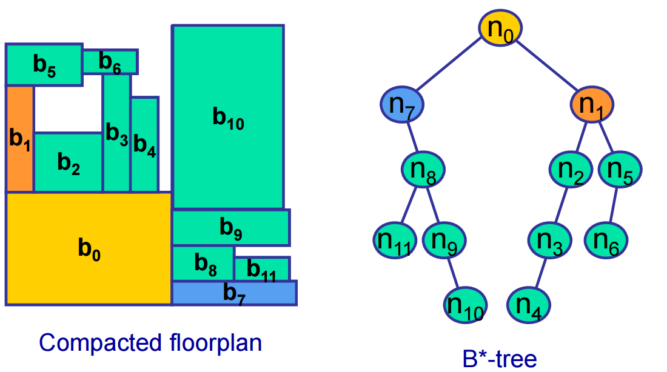

Slide 6
Class Node
Member
Node* _left, _right, _parent
int _x1, _x2, _y1, _y2
double _mid_x, _mid_y
string name
int _width, _height
int _nidx
Function
Nope!

Slide 7
Class Btree
Member
vector<int> _skyline
vector<Node*> _node_list
double _cost, _wire_len, _r_star
int _t_width, _t_height
int _root
Function
countCost
rotateLeft, rotateRight, rotateMacro
swap, deleteninsert

Slide 8
Simulated Annealing
a metaheuristic to approximate global optimization in a large search space

Slide 9
Our process is easy
Random Pick
Operation
(new state)
Temperature decay

Slide 10
Algorithm
Let s ← s0
While T > 0:
T ← decay(T)
s_new ← neighbor(s)
If value(s_new) <= value(s) or Probability > p:
s ← s_new
Output: the final state s

Slide 11
Operations
Rotate Left
Swap
Rotate Right
Rotate Macro
Delete & Insert

Slide 12
Tuning

Slide 13
Cost Functions
width
height
diff
area
ratio
(R*/R)

Slide 14
KEY: NORMALIZATION

Slide 15
Reflection

Slide 16
few hundreds lines
some parameters
solve NPC!!!
Total success!

Slide 17
Reference
Slides of physical design in class
Yao-Wen Chang
Electronic Design Automation: Synthesis, Verification, and Test~Ch10 Floorplanning
Yao-Wen Chang, Tung-Chieh Chen
Simulated annealing - Wikipedia

Slide 18
Thanks!
Any questions?

